Slide 1

Payroll Application
Esther Glazer
Rena Tanenbaum
Shaindy Koster

Slide 2
Features
Customizable benefits packages
1
Itemized paystub generator
2
Tax calculator
3
Multiple pay schedules
4

Slide 3
Customizable Benefits Packages
Benefits include health insurance and PTO
Option to add an infinite amount of variations
3 built-in options

Slide 4
Itemized Paystub Generator
Generates a file with updated pay information
Includes the YTD pay information
Displays the current benefits

Slide 5
Tax Calculator
Calculates tax for every pay
Generates gross pay and net pay
Takes into account factors such as dependents

Slide 6
Multiple pay schedules
Yearly
Monthly
Hourly

Slide 7

Add-on feature
For just a nominal fee, we will gladly extend the program to include clocking in/out functionality for every employee

Slide 8
Object Oriented
Person Class
Employee Class
Address Class

Slide 9
Utilizes
Validation
FileWriter
Enums

Slide 10
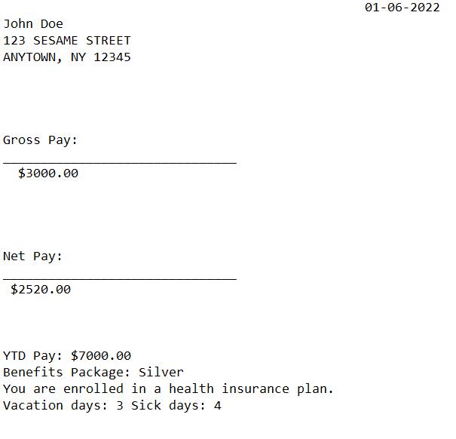
Sample paystub

Slide 11

How we did it
Zoom meetings
Zoom meetings
Zoom meetings
Zoom meetings
Zoom meetings
Zoom meetings

Slide 12
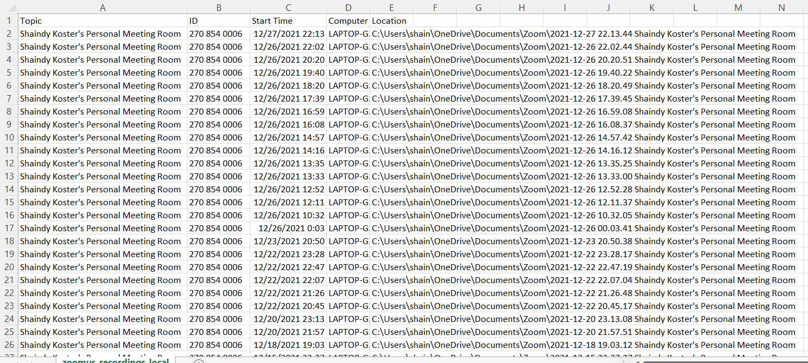
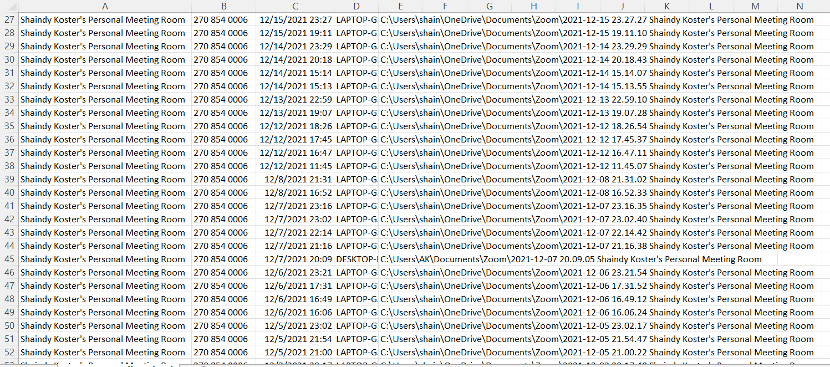
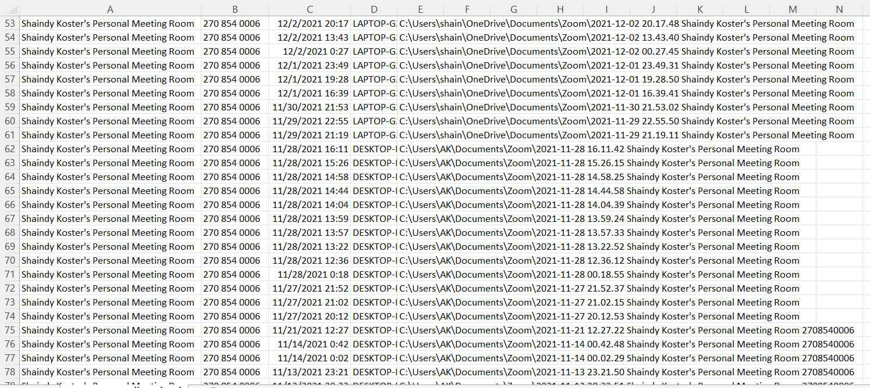

Slide 13

Thank you for watching
The end

